Slide 1
Patterns and Algebra
KAZIBA STEPHEN
28TH AUGUST 2024

Slide 2
Item 2
Sequence and patterns
Equation of lines and curves
Algebra 1 and 2
Mappings and relations
Vectors and translation
Inequalities and regions
Equation of a straight line
Simultaneous equations
Quadratic equations
Composite functions
Equations and inequalities
Linear programming
Loci

Slide 3
Linear programming (LP) or Linear Optimisation may be defined as the problem of maximizing or minimizing a linear function that is subjected to linear constraints.

Slide 4
LP APPLICATIONS
Engineering – It solves design and manufacturing problems as it is helpful for doing shape optimization
Efficient Manufacturing – To maximize profit, companies use linear expressions
Energy Industry – It provides methods to optimize the electric power system.
Transportation Optimization – For cost and time efficiency.

Slide 5
Components of Linear Programming
The basic components of the LP are as follows:
Decision Variables
Constraints
Data
Objective Functions

Slide 6
How to Solve Linear Programming Problems?
Step 1: Identify the decision variables.
Step 2: Formulate the objective function. Check whether the function needs to be minimized or maximized.
Step 3: Write down the constraints.
Step 4: Ensure that the decision variables are greater than or equal to 0. (Non-negative Constraint )
Step 5: Solve the linear programming problem using the graphical method.

Slide 7
Linear Programming by Graphical Method
Step 1: Write all inequality constraints in the form of equations.
Step 2: Plot these lines on a graph by identifying test points.
Step 3: Identify the feasible region. The feasible region can be defined as the area that is bounded by a set of coordinates that can satisfy some particular system of inequalities.
Step 4: Determine the coordinates of the corner points. The corner points are the vertices of the feasible region. Note – Applicable when corner points have bold boundary lines
Step 5: Substitute each corner point in the objective function. The point that gives the greatest (maximizing) or smallest (minimizing) value of the objective function will be the optimal point.

Slide 8
Maximizing the scores
Working space | Graph | Conclusion
Well defined variables Constraints- Non Negative inequality inclusive Objective Function – Specify whether it is sales, costs e t c Boundary line Table for coordinates Extract the coordinates Objective Function: Z = ax + by Constraints Non-negative restrictions | Title Axes well labeled Demarcation Labels with units were applicable Straight lines either bold or dotted depending on the inequality Define the unshaded region e.g wanted or unwanted Label the line as an equation not inequality Neat shading Scale | Back your conclusion with figures Write a full meaningful statement A possible table of combination may be used. Never read your combination from the dotted lines

Slide 9
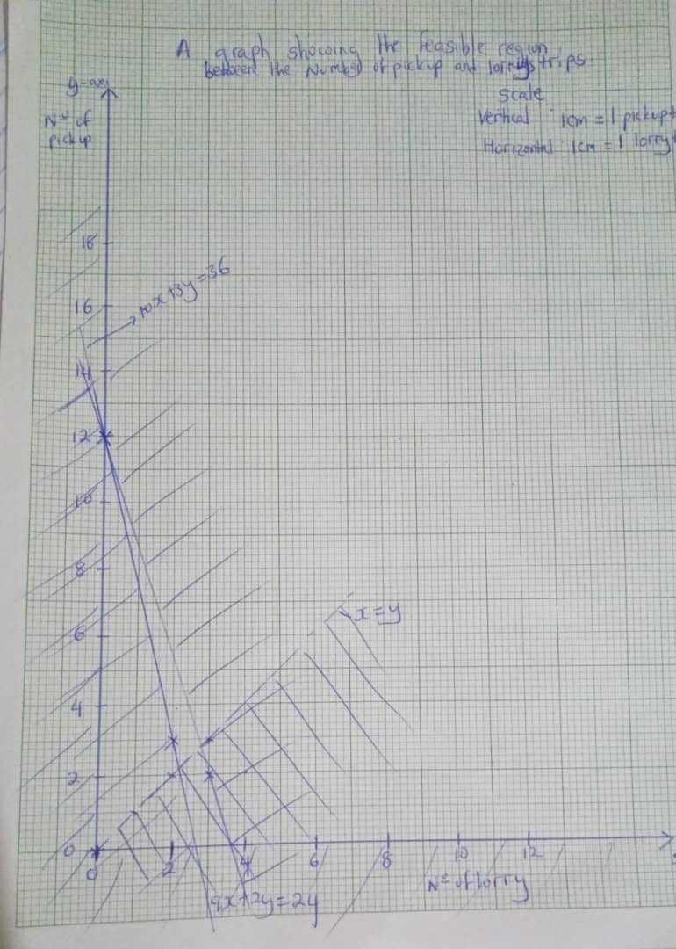

Slide 10
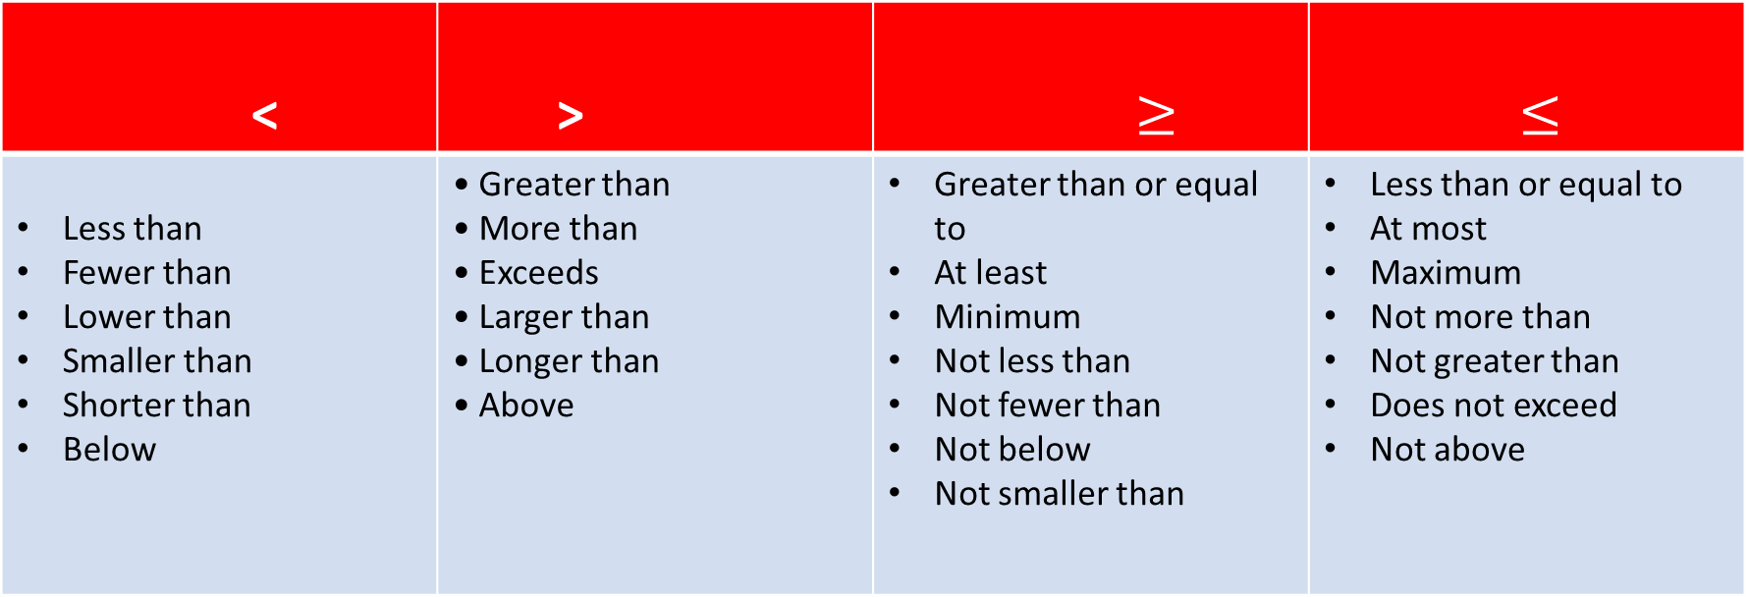
Symbols used for Specific inequality phrases
< | > | $≥$ | $≤$
Less than Fewer than Lower than Smaller than Shorter than Below | • Greater than • More than • Exceeds • Larger than • Longer than • Above | Greater than or equal to At least Minimum Not less than Not fewer than Not below Not smaller than | Less than or equal to At most Maximum Not more than Not greater than Does not exceed Not above

Slide 11
Steps of approaching the LPI
Define the variables to be used i.e x and y
Form the inequalities satisfying the given conditions including the non negativity constraints
Formulate the objective function i.e f(x,y) = ax + by
Graph all the inequalities and shade the unwanted region. Clearly locate the feasible points.
Optimise the Objective function

Slide 12
ACTIVITY
Forming inequalities from different scenarios

Slide 13
ACTIVITY 1
A furniture company has Shs 120,000 to invest in making tables and chairs. It costs Shs 20,000 to make each table and Shs 12,000 to make each chair. The company has a storage space of at least 8 items altogether. Each table yields a profit of Shs 80,000 and each chair a profit of Shs 45,000.
Find how many tables and chairs should be made so as to maximize profit and calculate this maximum profit

Slide 14
ACTIVITY 2
Ann has been sent to the nearby supermarket to buy some Apples and oranges . Apples cost sh.500 each and oranges cost sh.250 each. She is given only sh.2000 to spend. She must not buy more than 2 Apples and she must buy at least 4 oranges. She must also buy at least 6 fruits all together because her family has 6 members.
Find how many apples and oranges should be purchased so as to minimize her expenditure while maximizing purchases.

Slide 15
ACTIVITY 3
A store wants to liquidate 200 shirts and 100 pairs of pants from last season. They have decided to put together two offers, A and B. Offer A is a package of one shirt and a pair of pants which will sell for UGX 30,000 . Offer B is a package of three shirts and a pair of pants, which will sell for UGX 50,000 . The store does not want to sell less than 20 packages of Offer A and less than 10 of Offer B. How many packages of each do they have to deal to maximize the money generated from the promotion?

Slide 16
Item 4
A school is preparing a trip for 400 students. The company who is providing the transportation has 10 buses of 50 seats each and 8 buses of 40 seats, but only has 9 drivers available. The rental cost for a large bus is UGX 800,000 and for a small bus UGX 600,000. Calculate how many buses of each type should be used for the trip for the least possible cost.

Slide 17
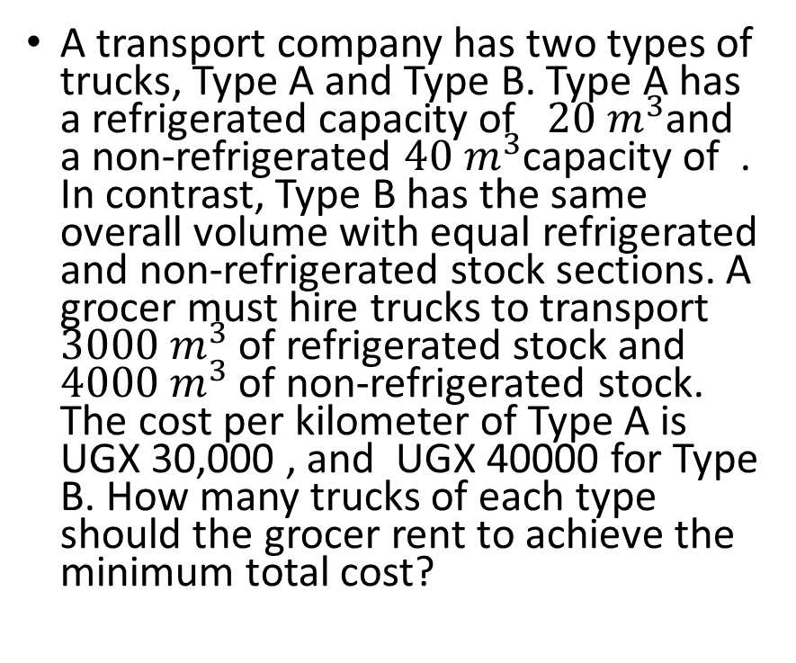
Item 5
A transport company has two types of trucks, Type A and Type B. Type A has a refrigerated capacity of ${20 m}^{3}$and a non-refrigerated ${40 m}^{3}$capacity of . In contrast, Type B has the same overall volume with equal refrigerated and non-refrigerated stock sections. A grocer must hire trucks to transport ${3000 m}^{3}$ of refrigerated stock and ${4000 m}^{3}$ of non-refrigerated stock. The cost per kilometer of Type A is UGX 30,000 , and UGX 40000 for Type B. How many trucks of each type should the grocer rent to achieve the minimum total cost?

Slide 18
Item 6
A school has organized a Geography study tour for 90 students.Two types of vehicles are needed;taxis and costa buses.The maximum capacity of the taxis is 15 passengers while that of the costa bus is 30 passengers.The number of taxis will be greater than the number of costa buses.The number of taxis will be less than five.The cost of hiring a taxis is Shs60,000 while that of the costa is Shs 100,000.There is only Shs 600,000 available.
(a) Write mathematical statements that show the relation between the number of taxis and the number of costa buses
(b) Find from your graph the number of taxis and costa buses which are full to capacity that must be ordered so that all the students are transported

Slide 19
Item 7
You have friends who rear cows and goats. During the festive season, they want to sell at most 10 of their cows and at least 8 of their goats. They also want to ensure that the number of goats they sell are less than twice the number of cows. They also do not want to sell more than 20 animals all together. They wish to maximise sales by selling each goat at Shs200,000/= and each cow at Shs1.5 millions but they do not know the number of goats and cows to sell to fulfil their wish.
Task:
(a) write mathematical statements that show the relation between the cows and goats.
(c) Help your friends to determine the maximum amount of money they will possibly make from the sale of cows and goats.

Slide 20
Item 8
Mr. Nika a tailor operates a small business by making dresses and shirts. After receiving training facilitated by a local NGO on how to improve small businesses and earn more, he started to have records about his daily operations.
In one week, he makes at least 4 dresses, not more than 7 shirts and less than 14 dresses and shirts all together. The number of shirts he makes is more than two thirds of the number of dresses.
TASK:
a) (i). Write down the information above using algebraic statements.
(i). Help Mr Nika to find the smallest number of dresses and shirts he makes in one week
b) The profit he makes on one dress is shs. 10,000 and the profit on a shirt is shs.6,000. Find the largest profit he can make in one week.

Slide 21
Item 9
The manager of the cinema hall wishes to divide the seats available into two classes executive and ordinary. There are not more than 120 seats available. There must be atleast twice as many ordinary seats as there are executive seats. Executive seats are priced at Shs 15,000 each. Ordinary seats are priced at Shs 10,000 each. At least Shs 1,000,000 should be collected at each show to meet the expenses
Task
Write down the information above using algebraic statements.
Show the feasible region
From your graph, find the number of seats of each kind which must be sold to give the maximum profit

Slide 23
ACTIVITY
A wholesaler wishes to transport at least 240 bags of sugar from the factory to his shop. He has a lorry that can carry 90 bags per trip and a pick up that can carry 20 bags per trip. The cost of each trip is Shs50,000 for the lorry and Shs 15,000 for a pick up. He has Shs180,000 available to transport the sugar. The pick up makes more trips than the lorry.
Task:
Write mathematical statements that show the relation between the lorry and the pick up.
Show the feasible region of the relation on the Cartesian plane.
c ) Use the graph to find the possible number of trips to be made by the lorry and the pick up .Hence find the minimum cost of transporting the bags of sugar

Slide 25
Your uncle owns a small bakery and plans to bake two types of loaves of bread: whole wheat bread and white bread. Due to the bakery's oven capacity, your uncle can bake at most 15 loaves of bread in a day. He wants to bake at least 3 loaves of whole wheat bread. Additionally, he wants to bake more whole wheat bread than white bread because it is more popular among his customers. The selling prices are as follows:
Whole wheat bread is sold at Shs 6500 per loaf. White bread is sold at Shs 5000 per loaf.
To cover his costs and make a profit, your uncle needs to earn more than Shs 30,000 from the sales each day.
Task:
Write mathematical statements that show the relation between the whole wheat bread and white bread.
Show the feasible region of the relation on the Cartesian plane.
How many loaves of each type should your uncle bake in order to make the maximum profit?
What is the minimum number of loaves he can bake and still make a profit?

Slide 26
You are in a management committee that is organizing a farewell party. The committee wants to establish the number of people to attend the party keeping the cost as minimum as possible. You have been assigned a department of drinks which has a maximum amount of Ugx 450,000. You are planning to buy creates of soda and jerrycans of juice. Each crate of soda costs ugx 20,000 a jerrycans of juice Ugx 30,000. You intend to buy more crates of soda than jerrycans of juice. The jerrycans of juice should be more than 6 and the crates of soda should be less than 12. Each person will be served only one type of drink once and in the budget 24 students are to take a crate of soda and 20 students are to take a full jerrycans of juice.
TASK
a) Write down mathematical statements to show the relation between the number of crates of soda and number of jerrycans of juice.
b) Show the feasible regions of the relation or a Cartesian plane.
c) Help the committee establish the number of students who are to attend the party at a minimum cost.

Slide 27
Graphing Systems of Linear Inequalities
To determine the optimal solution There are two techniques
1. Corner Point Method
Corner-point method is a method for solving graphical linear programming problems. The mathematical theory behind linear programming states that an optimal solution to any problem will lie at a corner point, or an extreme point, of the feasible region. Hence, it is necessary to find only the values of the variables at each corner; the optimal solution will lie at one or more of them. This is the corner-point method.
2. ISO-Profit (or Cost) method
ISO-profit line method is an approach to identifying the optimum point in a graphic linear programming problem. The line representing the objective function and touches a particular point of the feasible region will pinpoint the optimal solution. Once the feasible region has been graphed, one can find the optimal solution to the problem. The optimal solution is the point lying in the feasible region that produces the highest profit.

